Slide 1

“ Sign Sense System using Convolutional Neural NetworkAlgorithm” Major project report submitted to Rajiv Gandhi University of Knowledge Technologies SRIKAKULAM In partial fulfillment of the requirements for the award of the degree of BACHELOR OF TECHNOLOGY IN COMPUTER SCIENCE Submitted by 4th year B. Tech 1st semester K.Lavanya(S180198) M. Manikanta (S180981) G. Jyothsna (S180845) Under the Esteemed Guidance of T. Anil kumar ,Assistant Professor

Slide 2
Sign Sense system using Convolutional neural network Algorithm

Slide 3
Contents
Problem statement
Abstract
Existed system
Proposed system
CNN Algorithm
Literature survey
Future scope
References

Slide 4
PROBLEM STATEMENT
Develop a robust and accurate Traffic Sign Recognition System (TSRS) that can automatically detect and classify traffic signs from images or video streams captured by cameras installed on vehicles. The TSRS should be capable of recognizing a wide variety of traffic signs, including regulatory, warning, and informational signs, and provide real-time information to assist drivers in making safe and informed decisions on the road.

Slide 5
ABSTRACT
In today's world, almost everything we do has been simplified by automated tasks. In an attempt to focus on the road while driving, drivers often miss out on signs on the side of the road, which could be dangerous for them and for the people around them. This problem can be avoided if there was an efficient way to notify the driver without having them to shift their focus. Traffic Sign Detection and Recognition plays an important role here by detecting and recognizing a sign, thus notifying the driver of any upcoming signs. This not only ensures road safety, but also allows the driver to be at little more ease while driving on tricky or new roads. Another commonly faced problem is not being able to understand the meaning of the sign. With the help of this Advanced Driver Assistance Systems application, drivers will no longer face the problem of understanding what the sign says. In this project, we propose a method for Traffic Sign Detection and Recognition using image processing for the detection of a sign and an ensemble of Convolutional Neural Networks (CNN) for the recognition of the sign.
Keywords – Convolution neural network, Feature extraction, Road accidents, Traffic sign recognition

Slide 6
SYSTEM REQUIREMENTS:
Software Requirements:
Jupyter note book.
System camera
Windows 10
Hardware Requirements:
RAM: 4GB above
Hard disk: 500 GB above

Slide 7
Existed system
Classification algorithms
Variations in lighting conditions
Background complexity
Lack of standardization
Less accuracy
Low response time

Slide 8
PROPOSED SYSTEM
CNN Algorithm
Improved accuracy
Faster response time
Increased efficiency
Scalability
Variations in lighting conditions

Slide 9
Convolutional Neural Network Algorithm
CNN is one of the neural network models for deep learning, which has three specific characteristics, firstly it takes locally connected neurons, secondly, it calculates shared weight and finally gives the spatial or temporal sub-sampling. Generally, CNN is compromised of two main parts . The first contains alternating Convolutional and second is the maxpooling layers. The input of each layer is just the output of its previous layer. As a result, this forms a hierarchical feature extractor that maps the original input images into feature vectors. Then the second part classifies the extracted features vectors, that is, the fully-connected layers, which is a typical feed-forward neural network.

Slide 10
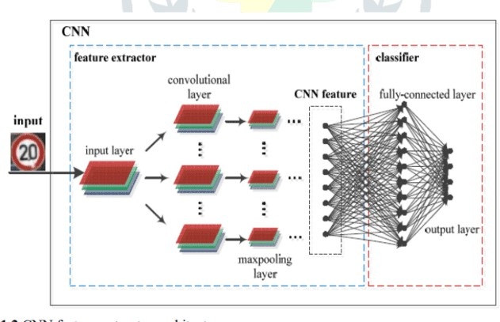

Slide 11
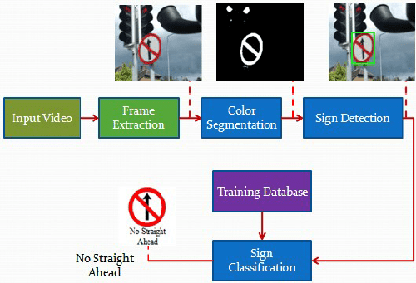
SIGN DETECTIO MODEL

Slide 12
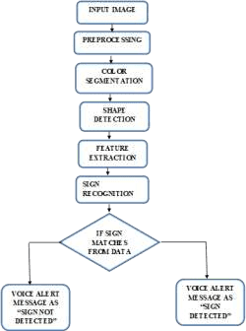
Flow chart

Slide 13
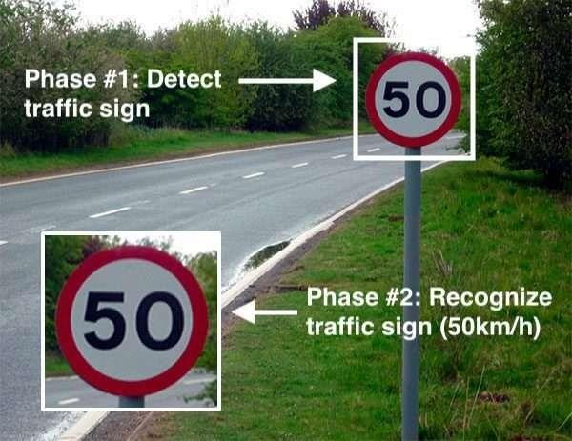

Slide 14
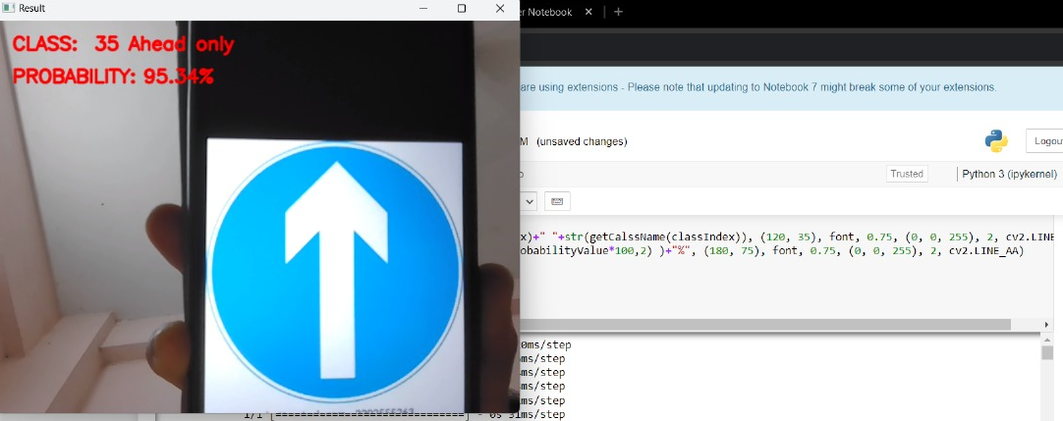
Example:

Slide 15
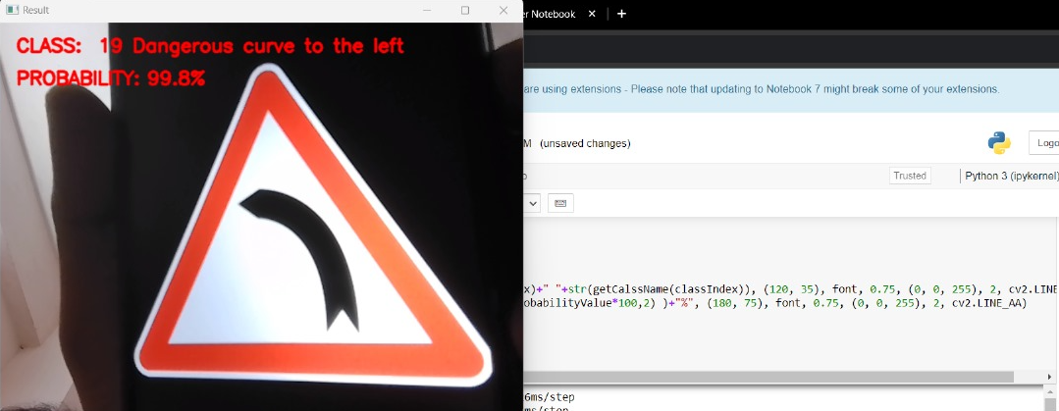

Slide 16
Literature survey:
Object detection and recognition techniques: This involves studying different techniques used for object detection and recognition in traffic sign recognition, such as Haarcascades, HOG features, and deep learning techniques.
Feature extraction techniques: Different feature extraction techniques such as color-based features, shape-based features, texture-based features, and combination features can be reviewed.
Classification algorithms: This involves studying different classification algorithms such as SVM, KNN, Naive Bayes, and neural network-based approaches, which are commonly used in traffic sign recognition.
Datasets: A survey of traffic sign recognition would require the evaluation of various datasets used in traffic sign recognition, such as BelgiumTS, and LISA.
Challenges: Understanding the challenges faced in traffic sign recognition such as variations in lighting conditions, occlusion, and background complexity

Slide 17
https://ieeexplore.ieee.org/document/9498270
https://youtu.be/BvYFGScsE7Y
https://www.studocu.com/in/document/visvesvaraya- technological-university/computer-communication- networks/traffic-sign-detection-recognition-system- report/30131569
https://www.powershow.com/view/16db73- YmNkM/Traffic_Sign_Recognition_powerpoint_ppt_pres entation
https://www.slideserve.com/zada/traffic-sign-recognition
https://www.slideshare.net/anujraghav123/traffic-sign-recognition-183188970
https://www.slideshare.net/cseij/trafficsign-recognition-for-an-intelligent-vehicledriver-assistant-system-using- hog
https://www.ijert.org/traffic-sign-recognition-using-machine-learning-a-review

Slide 18
FUTURE SCOPE
Multi-task learning: The system can be extended to recognize multiple tasks simultaneously, such as detecting and recognizing road markings, pedestrian crossings, and traffic lights.
Multi-camera systems: The system can be extended to work with multi- camera systems, which can provide a more comprehensive view of the road and improve accuracy.
Object detection: The system can be enhanced to detect and recognize other objects, such as vehicles, pedestrians, and cyclists, which can improve road safety and traffic management.

Slide 19
REFERENCES
https://ieeexplore.ieee.org/document/9498270
https://youtu.be/BvYFGScsE7Y
https://www.slideshare.net/anujraghav123/traffic-sign- recognition-183188970
https://www.slideshare.net/cseij/trafficsign-recognition- for-an-intelligent-vehicledriver-assistant-system-using- hog

Slide 20
THANK YOU

